Slide 1

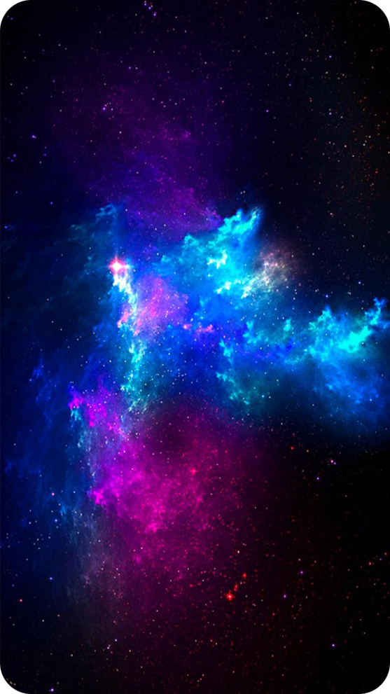
Beyond Earth: An Interactive Space Exploration App
Embark on a journey through the cosmos with "Beyond Earth," an interactive web application designed to teach you about the wonders of space. Dive into real-time simulations, visualize celestial objects in 3D, and learn about the physics that govern their motion.

Slide 2


Interactive Learning
1
Hands-On Exploration
Manipulate and observe the motion of planets, stars, asteroids, and other space objects in real-time.
2
Unveiling Cosmic Mysteries
Gain a deeper understanding of concepts like momentum, gravity, and orbital dynamics through interactive simulations.
3
Personalized Learning
"Beyond Earth" caters to all levels of learning, whether you're a beginner or an experienced space enthusiast.

Slide 3
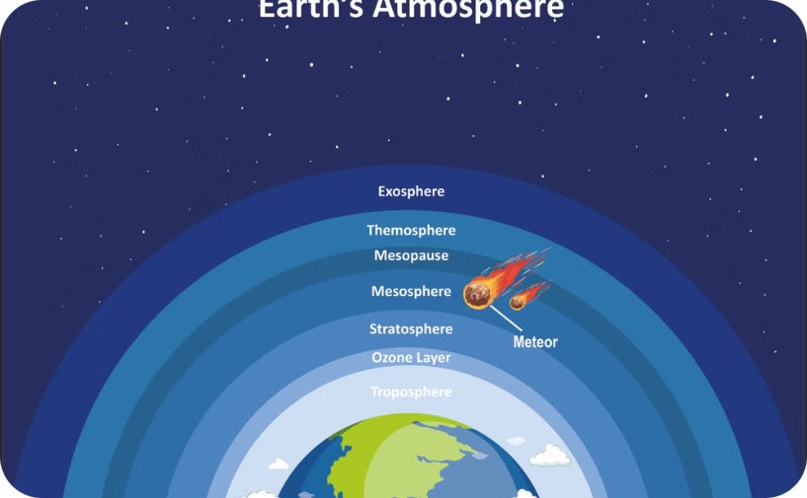
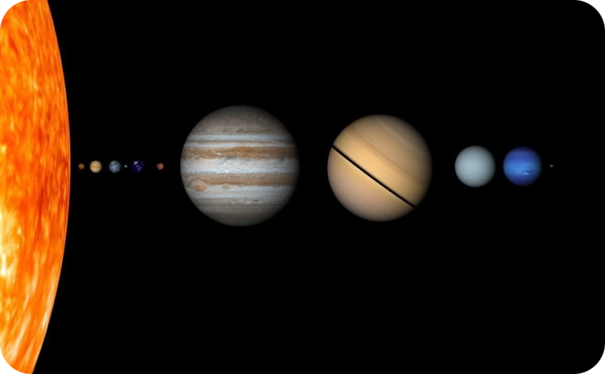
3D Visualization of Celestial Objects
Immersive Views
Scientific Accuracy
Zoom in and out of planets, moons, stars, and asteroids to study their intricate details and learn about their unique characteristics.
3D models are built using Blender and Three.js to ensure realistic and scientifically accurate representations of celestial objects.

Slide 4

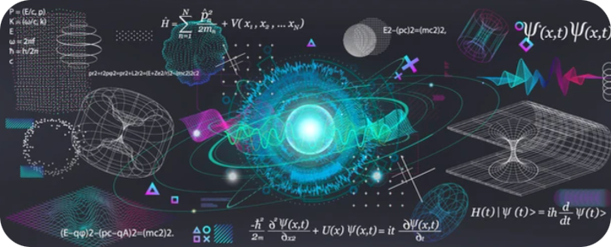
Physics Simulations and Momentum Analysis
1
2
3
Gravitational Forces
Momentum and Velocity
Centrifugal Force
Experiment with the effects of gravity on the motion of celestial bodies. Observe how gravity influences their trajectories, speeds, and orbital paths.
Set initial conditions, such as speed and direction, and observe how these factors affect the motion of celestial objects.
Explore the concept of centrifugal force and how it plays a role in keeping celestial bodies in orbit around a larger object.

Slide 5

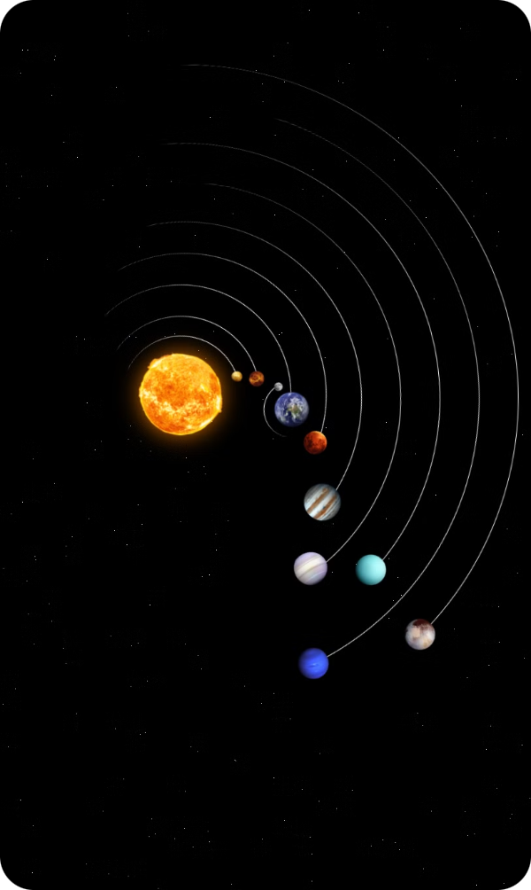
User-Friendly Interface
Intuitive Controls
Navigate seamlessly through the app, manipulate 3D models, and interact with simulations using simple and intuitive controls.
Responsive Design
"Beyond Earth" is accessible across multiple devices, ensuring a smooth and enjoyable learning experience for all users.
Accessible Learning
The user-friendly interface makes "Beyond Earth" accessible to learners of all ages and technical backgrounds.

Slide 6

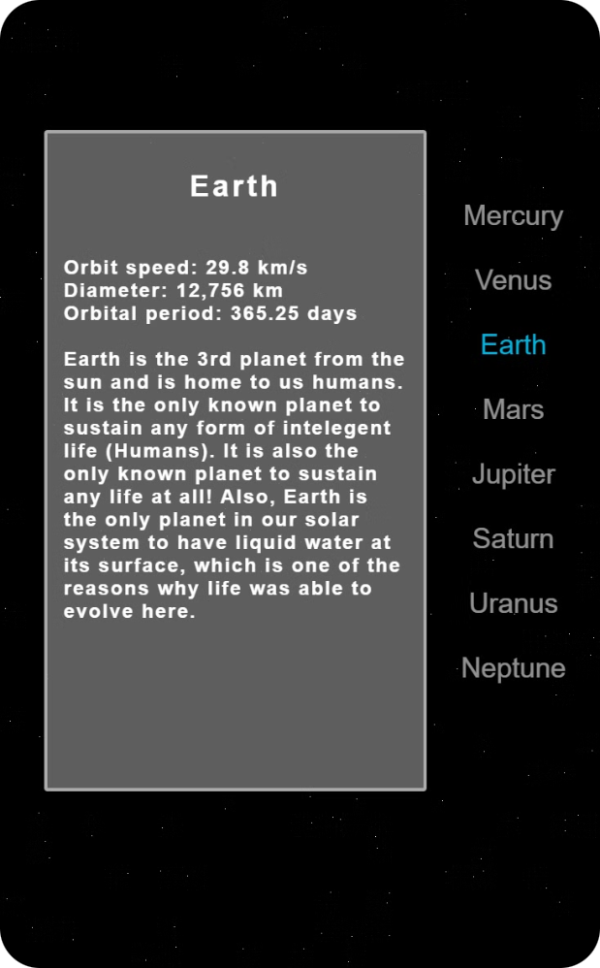


Content and Visual Enrichment
Stunning Visuals
Celestial models are enriched with assets from Sketchfab, ensuring both educational value and captivating visuals.
Engaging Animations
Animations and illustrations bring complex scientific principles to life, making them easier to understand.

Slide 7

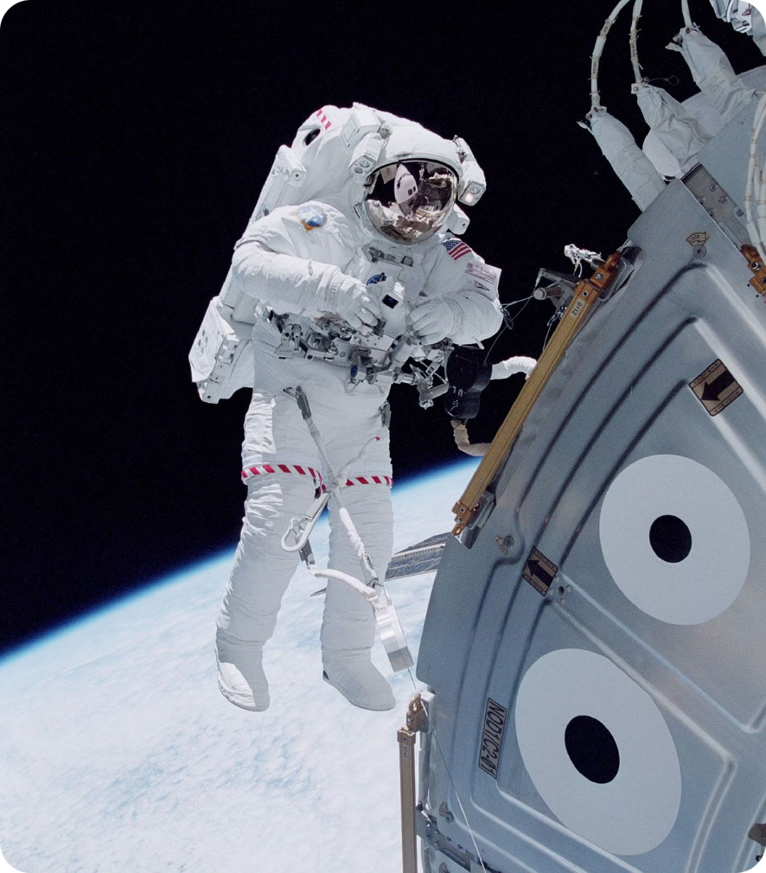



Learning Modules and Exploration
Structured Learning
Explore structured learning modules covering key concepts like Newton's laws of motion, Kepler's laws of planetary motion, and the fundamentals of astrophysics.
Free Exploration
Experiment with different celestial bodies, adjust their physical parameters, and delve into their unique features and behavior in space.
Expanding Knowledge
Gain a deeper understanding of the cosmos, from the basics of celestial mechanics to the intricacies of astrophysics.

